Slide 1
Beta-diversity, composition and turnover

Slide 2
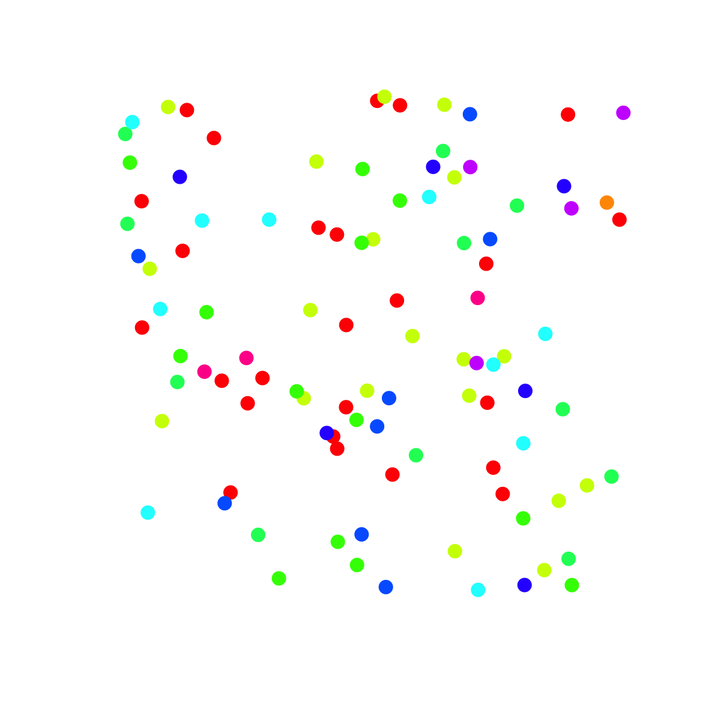
Diversity: how to quantify it?
How many different identities?

Slide 3
Diversity: how to quantify it?
How many different identities?
How even are the abundances of
the different identities?

Slide 4
Diversity: how to quantify it?
How many different identities?
How even are the abundances of
the different identities?
Want a metric that reflects both properties of diversity (richness and evenness)
- Hill numbers (Hill 1973 Ecology)
- numbers equivalent
- effective number of elements

Slide 5
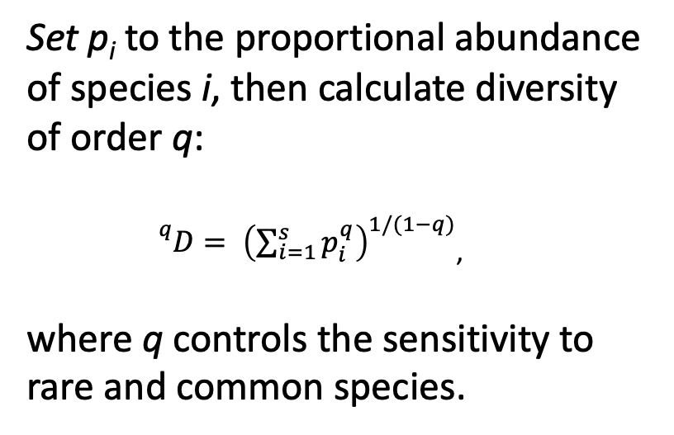
Diversity: how to quantify it?
Set p_{i} to the proportional abundance of species i, then calculate diversity of order q:
${}_{}^{q}{D=} {\left(\sum_{i=1}^{s}{p_{i}^{q}}\right)}^{1/(1−q)}$,
where q controls the sensitivity to rare and common species.
Hill 1973 Ecology, Jost 2007 Ecology

Slide 6
Diversity: how to sample it?

Slide 7
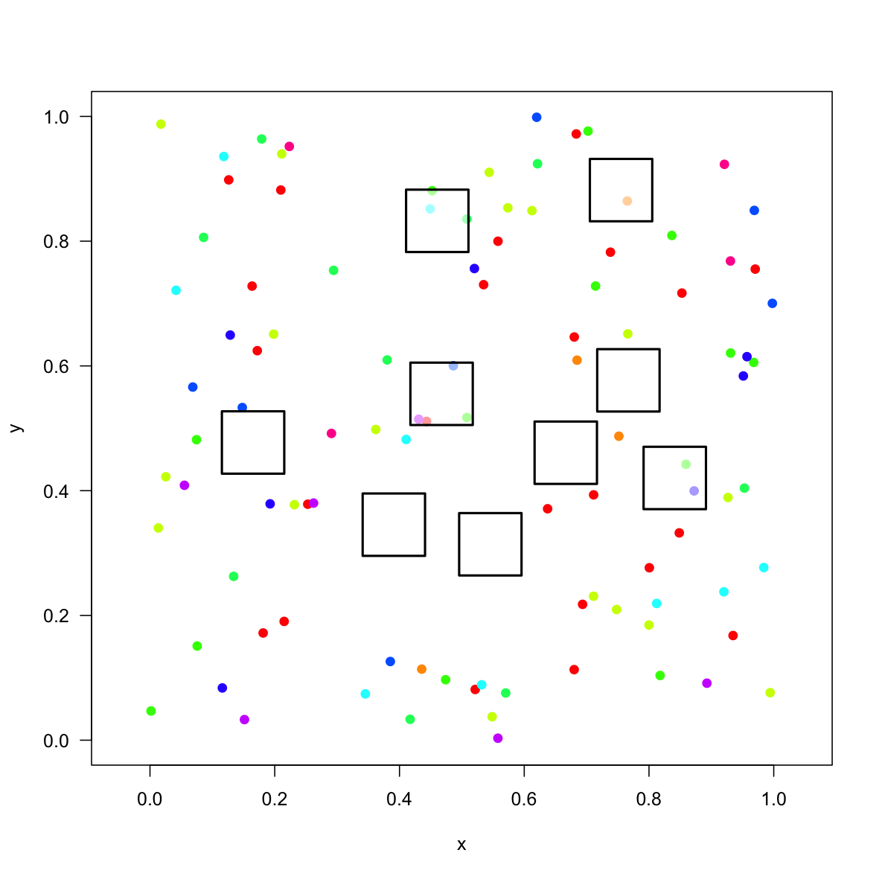
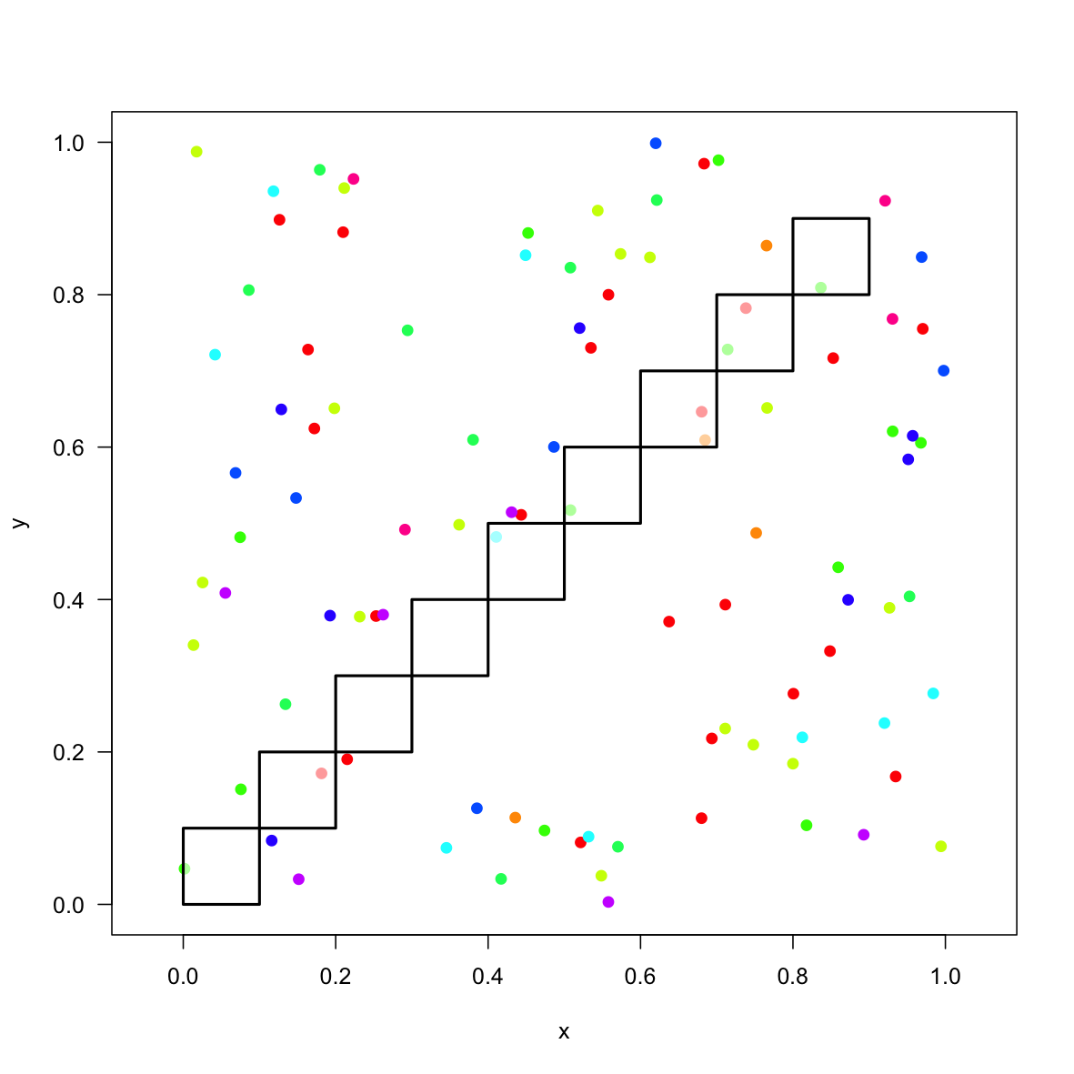
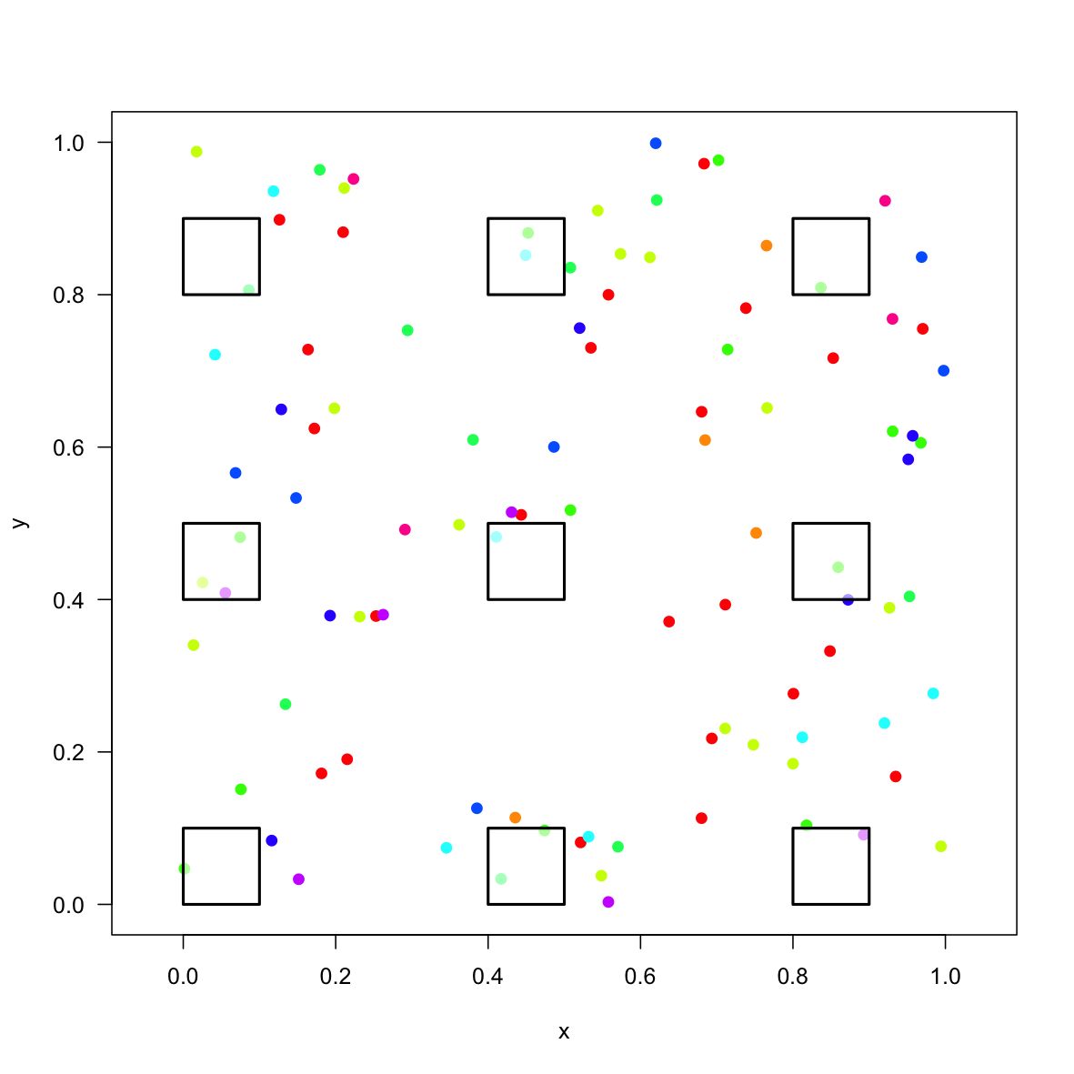
Diversity: how to sample it?

Slide 8
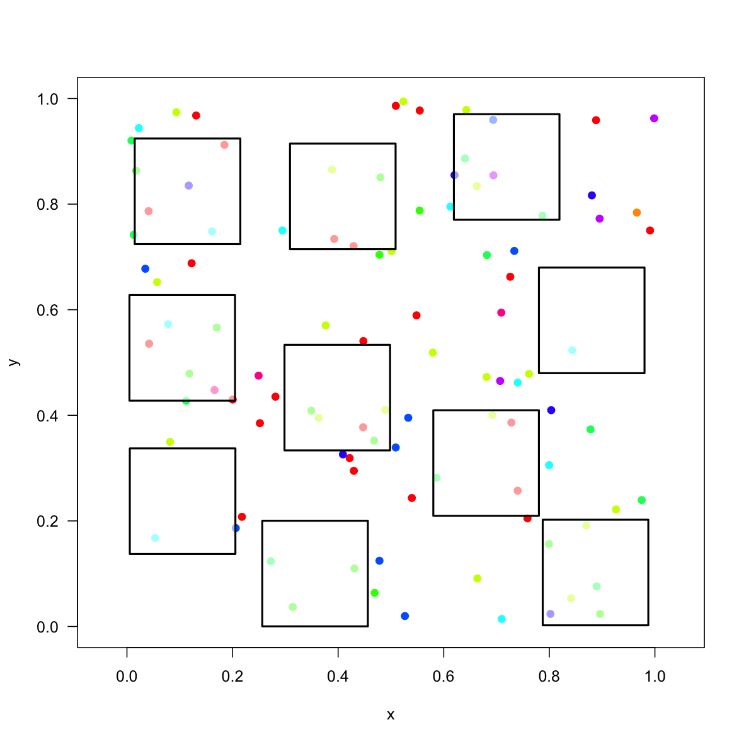
Local or 𝛼-scale diversity

Slide 9
Regional or 𝛾-scale diversity
Pooled diversity in all the local samples

Slide 10

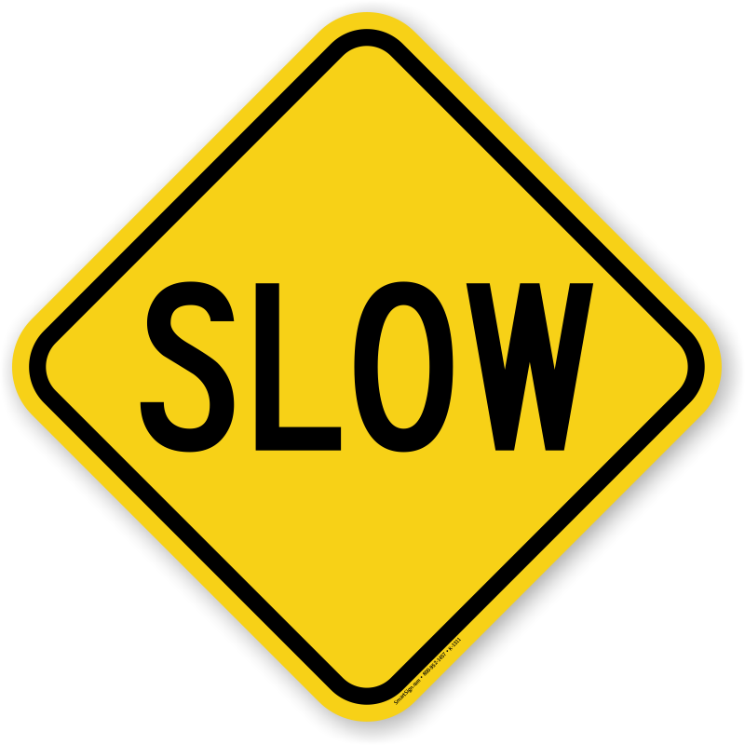
𝛽-diversity scales between 𝛼- and 𝛾-diversity.

Slide 11
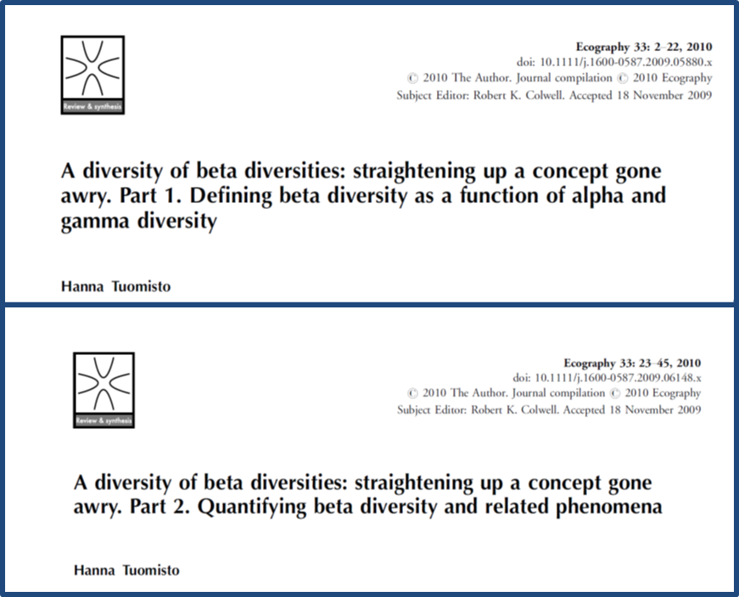


Slide 12
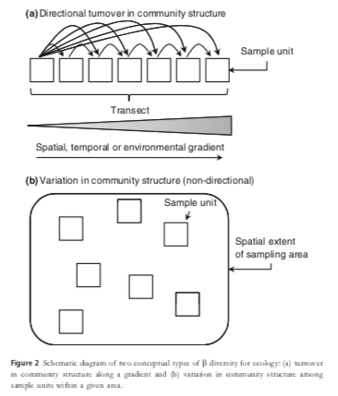
Navigating the multiple meanings of beta diversity: a roadmap for the practicing ecologist
Anderson et al. 2011 Ecology Letters

Slide 13
Navigating the multiple meanings of beta diversity: a roadmap for the practicing ecologist
Anderson et al. 2011 Ecology Letters

Slide 14
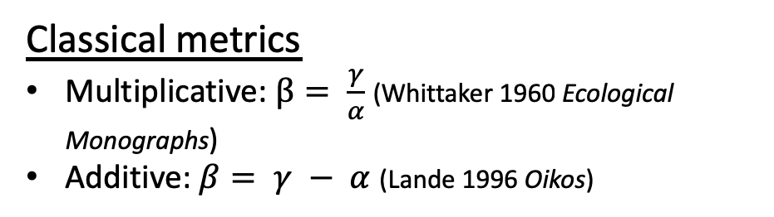
Navigating the multiple meanings of beta diversity: a roadmap for the practicing ecologist
Classical metrics
Multiplicative: $β= \frac{γ}{α}$ (Whittaker 1960 Ecological Monographs)
Additive: $β= γ − α$ (Lande 1996 Oikos)
Anderson et al. 2011 Ecology Letters

Slide 15
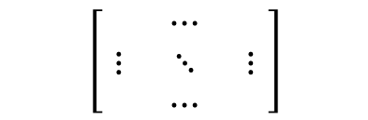
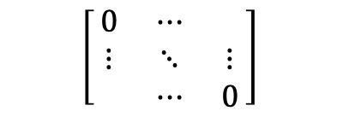
Navigating the multiple meanings of beta diversity: a roadmap for the practicing ecologist
Multivariate metrics
Community matrix:
Species
$$\left[\begin{matrix} & ⋯ & \\ ⋮ & ⋱ & ⋮ \\ & ⋯ & \end{matrix}\right]$$
Sites
Dissimilarity matrix: d_{ij}
Pair-wise dissimilarities among the samples
$$\left[\begin{matrix}0 & ⋯ & \\ ⋮ & ⋱ & ⋮ \\ & ⋯ & 0\end{matrix}\right]$$
Anderson et al. 2011 Ecology Letters

Slide 16
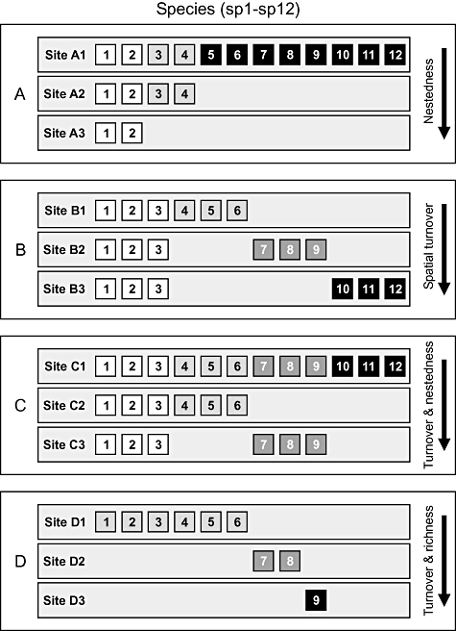
What about partitioning the dissimilarities?
Baselga 2010 Global Ecology & Biogeography

Slide 17
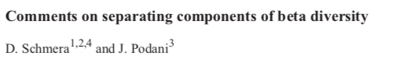
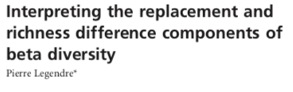
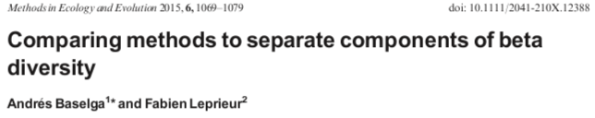
What about partitioning the dissimilarities?
But…
Baselga 2010 Global Ecology & Biogeography

Slide 18
Back to the classics with the MoB
Chase et al. 2018 Ecology Letters

Slide 19
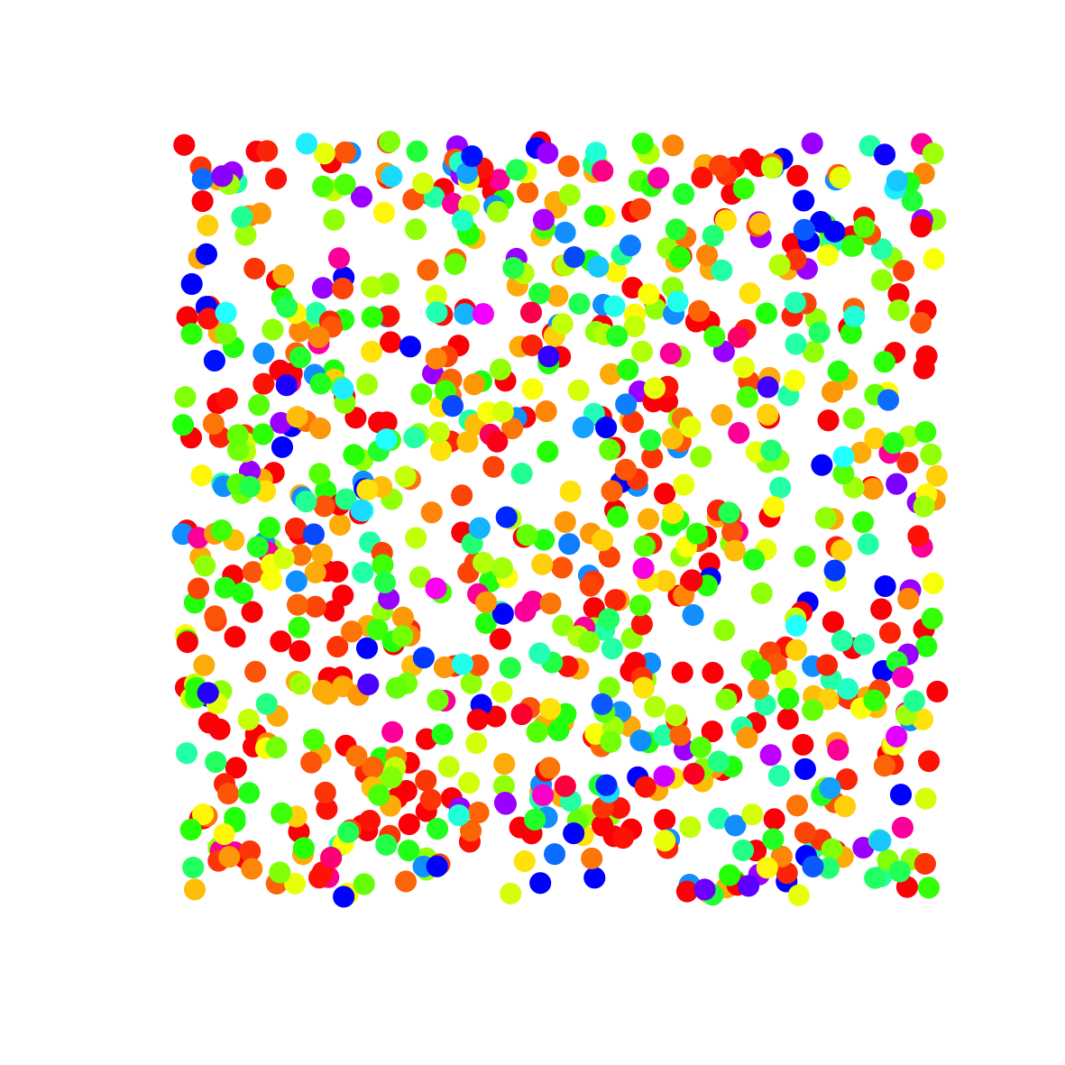
Quantifying 𝛽-diversity in the Measurement of Biodiversity (MoB) framework
Chase et al. 2018 Ecology Letters

Slide 20
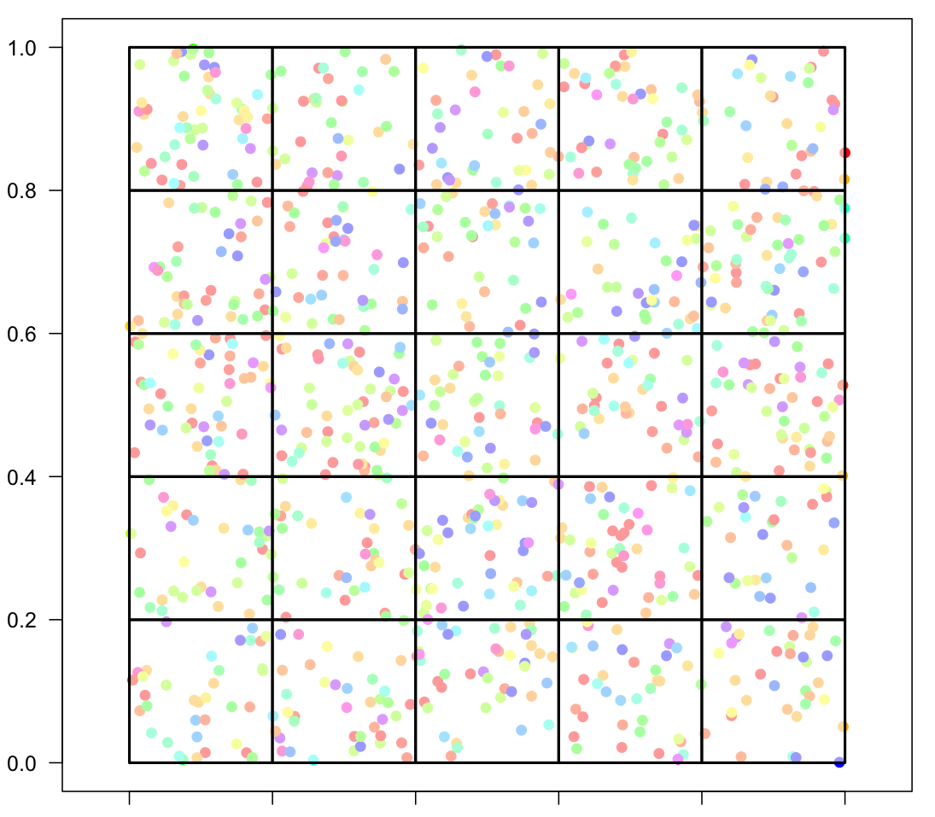
Quantifying 𝛽-diversity using MoB
Chase et al. 2018 Ecology Letters

Slide 21
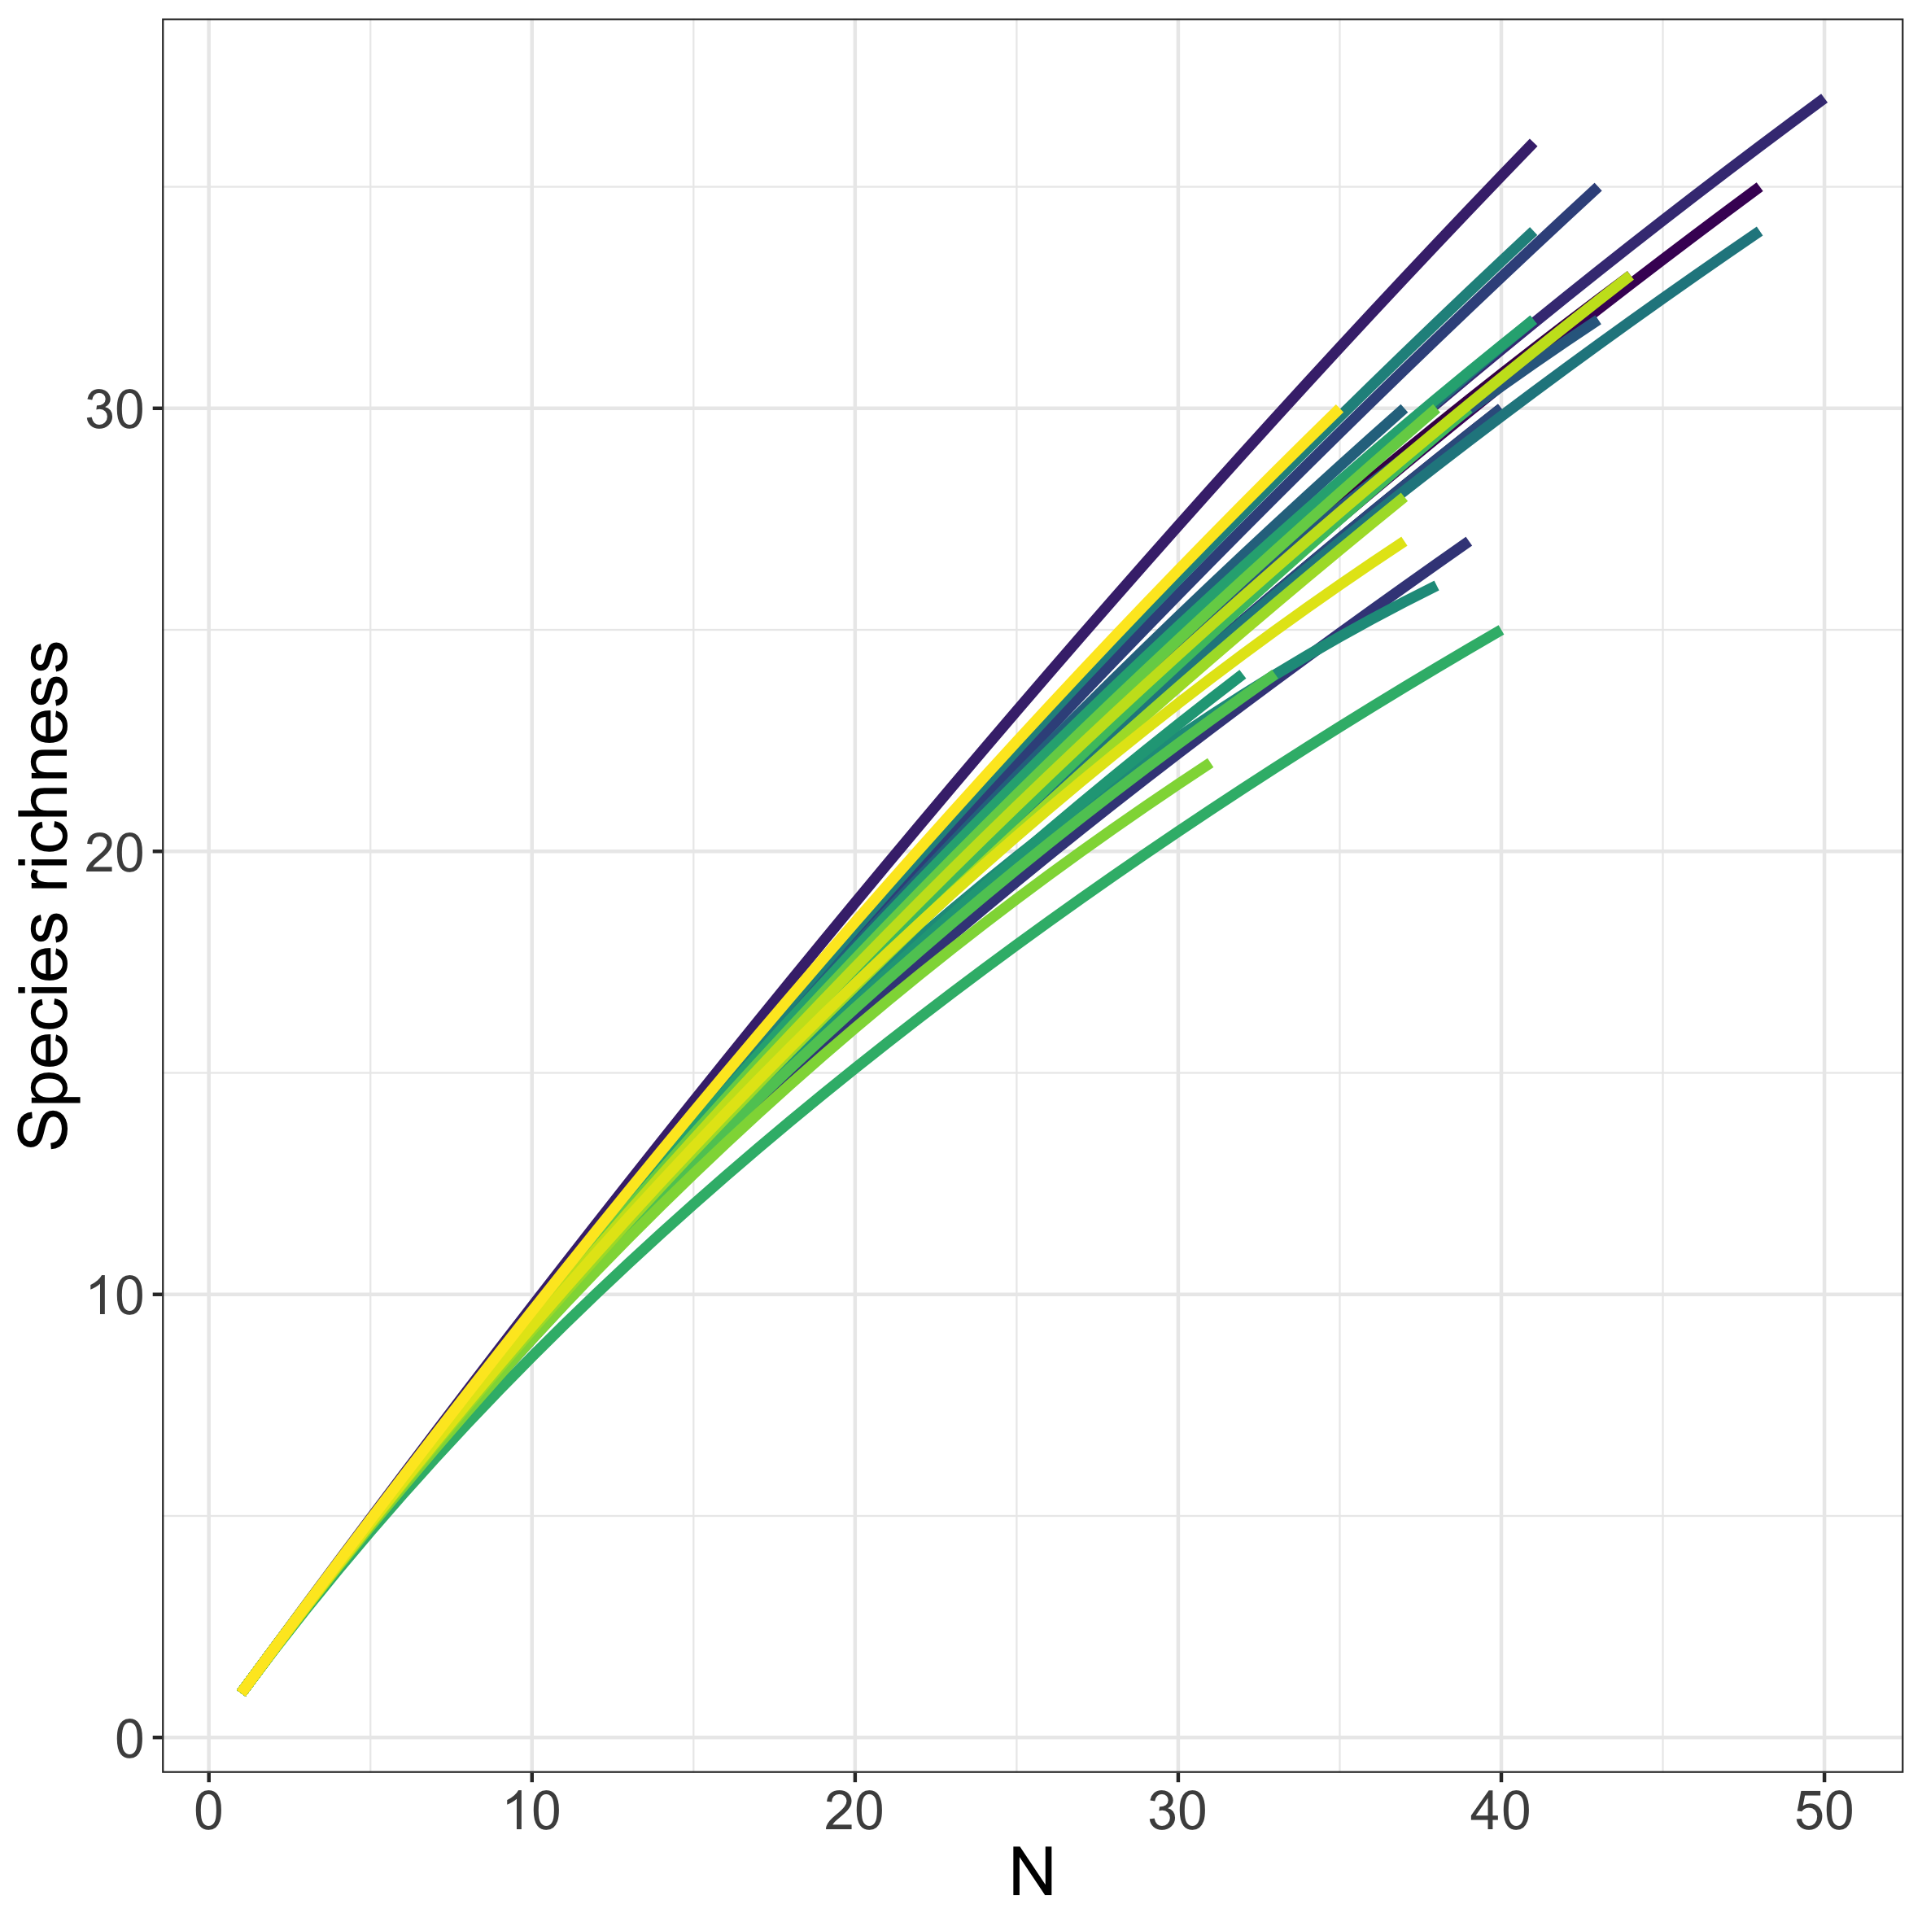
Quantifying 𝛽-diversity using MoB
Individual-based rarefaction: 𝛼-scale

Slide 22
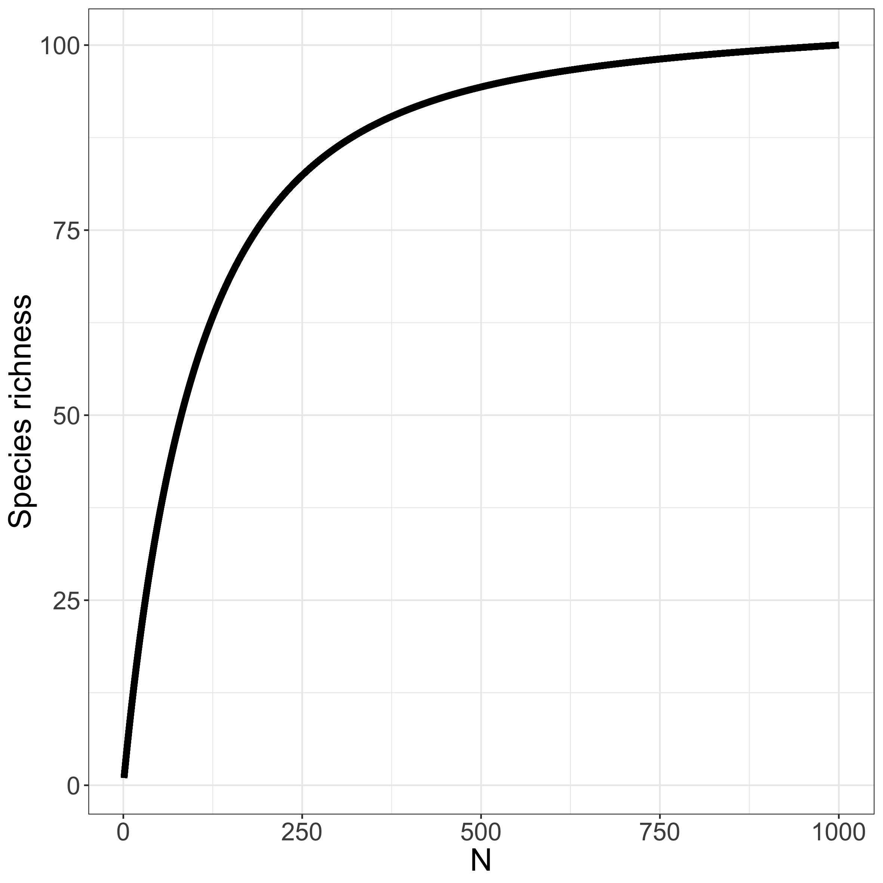
Quantifying 𝛽-diversity using MoB
Individual-based rarefaction: 𝛾-scale

Slide 23
Quantifying 𝛽-diversity using MoB
Combine rarefaction curves from 𝛾- and 𝛼-scales to calculate 𝛽 (= 𝛾/𝛼).
Chase et al. 2018 Ecology Letters

Slide 24
Why 𝛽-diversity?
Fishes on coral reefs have strikingly similar patterns of species richness across latitude and longitudes.
Blowes et al. 2017 Proc Roy Soc B

Slide 25
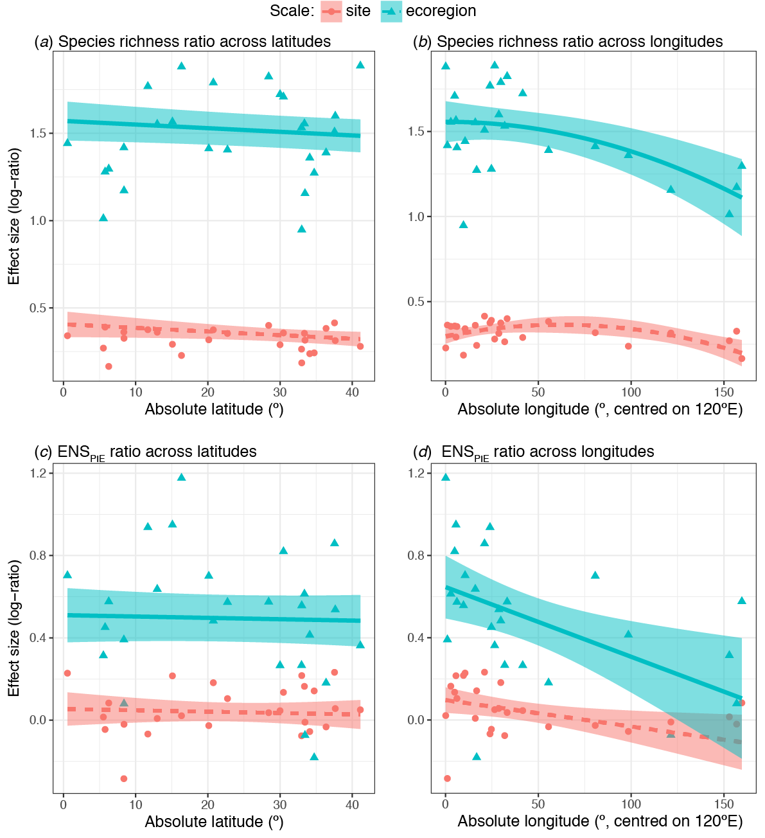
Why 𝛽-diversity?
Fishes on coral reefs have strikingly similar patterns of species richness across latitude and longitudes.
Longitudinal pattern is associated with 𝛽-diversity, particularly of common species.
Blowes et al. 2017 Proc Roy Soc B

Slide 26
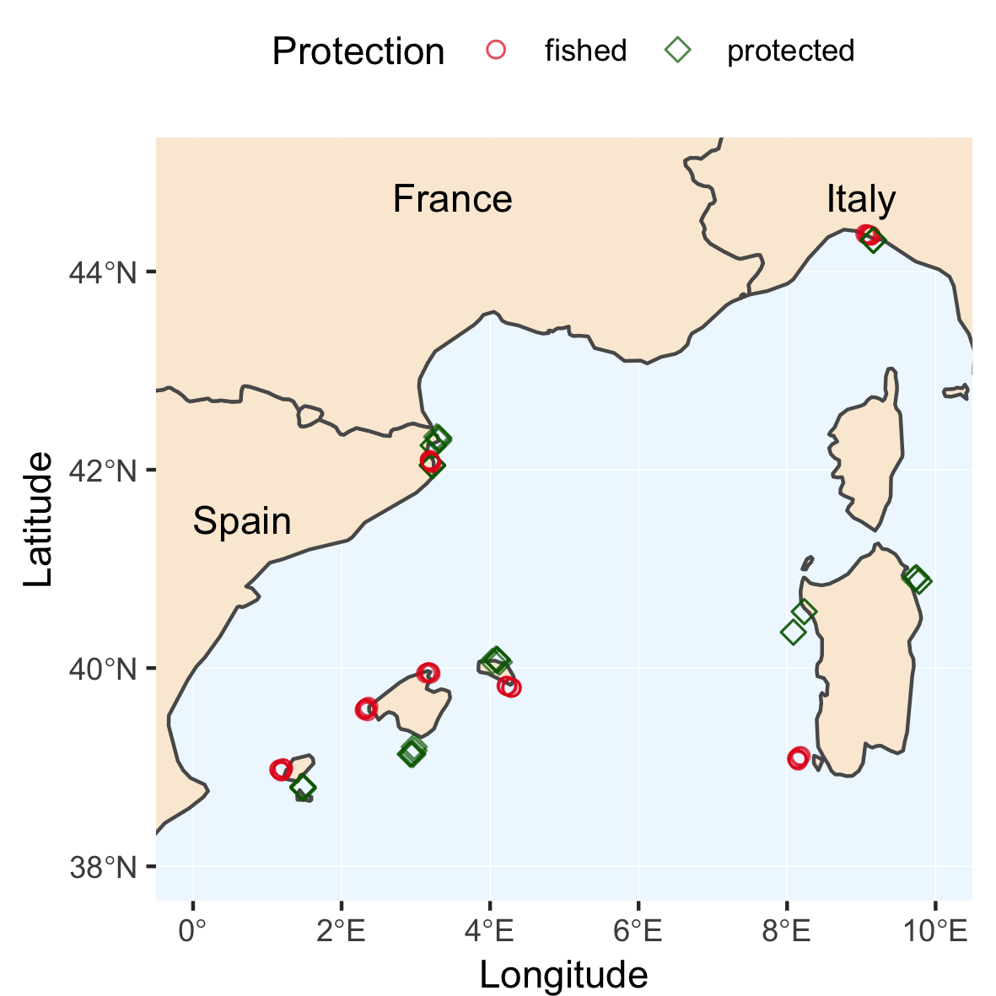
Why 𝛽-diversity?
Marine protected networks are a common conservation strategy to protect fish from exploitation.
Whether and how the ‘network’ works can be addressed with 𝛽-diversity.
Blowes et al. 2020 J Appl Ecol

Slide 27
Why 𝛽-diversity?
𝛽-diversity is higher in protected areas.
High site-to-site variation of common exploited species means different species are returning to different protected areas across the network.
Blowes et al. 2020 J Appl Ecol

Slide 28
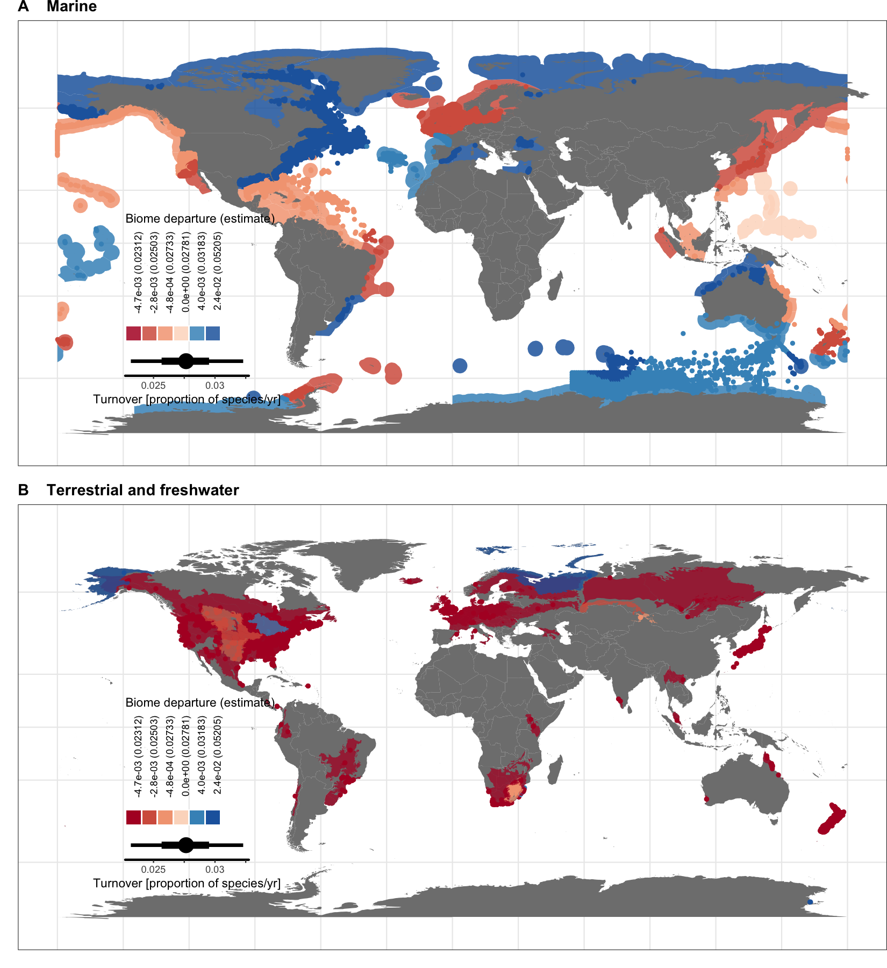
Why 𝛽-diversity?
Compositional turnover (temporal 𝛽-diversity) is widespread, and faster in marine compared to terrestrial assemblages.
Blowes et al. 2019 Science

Slide 29
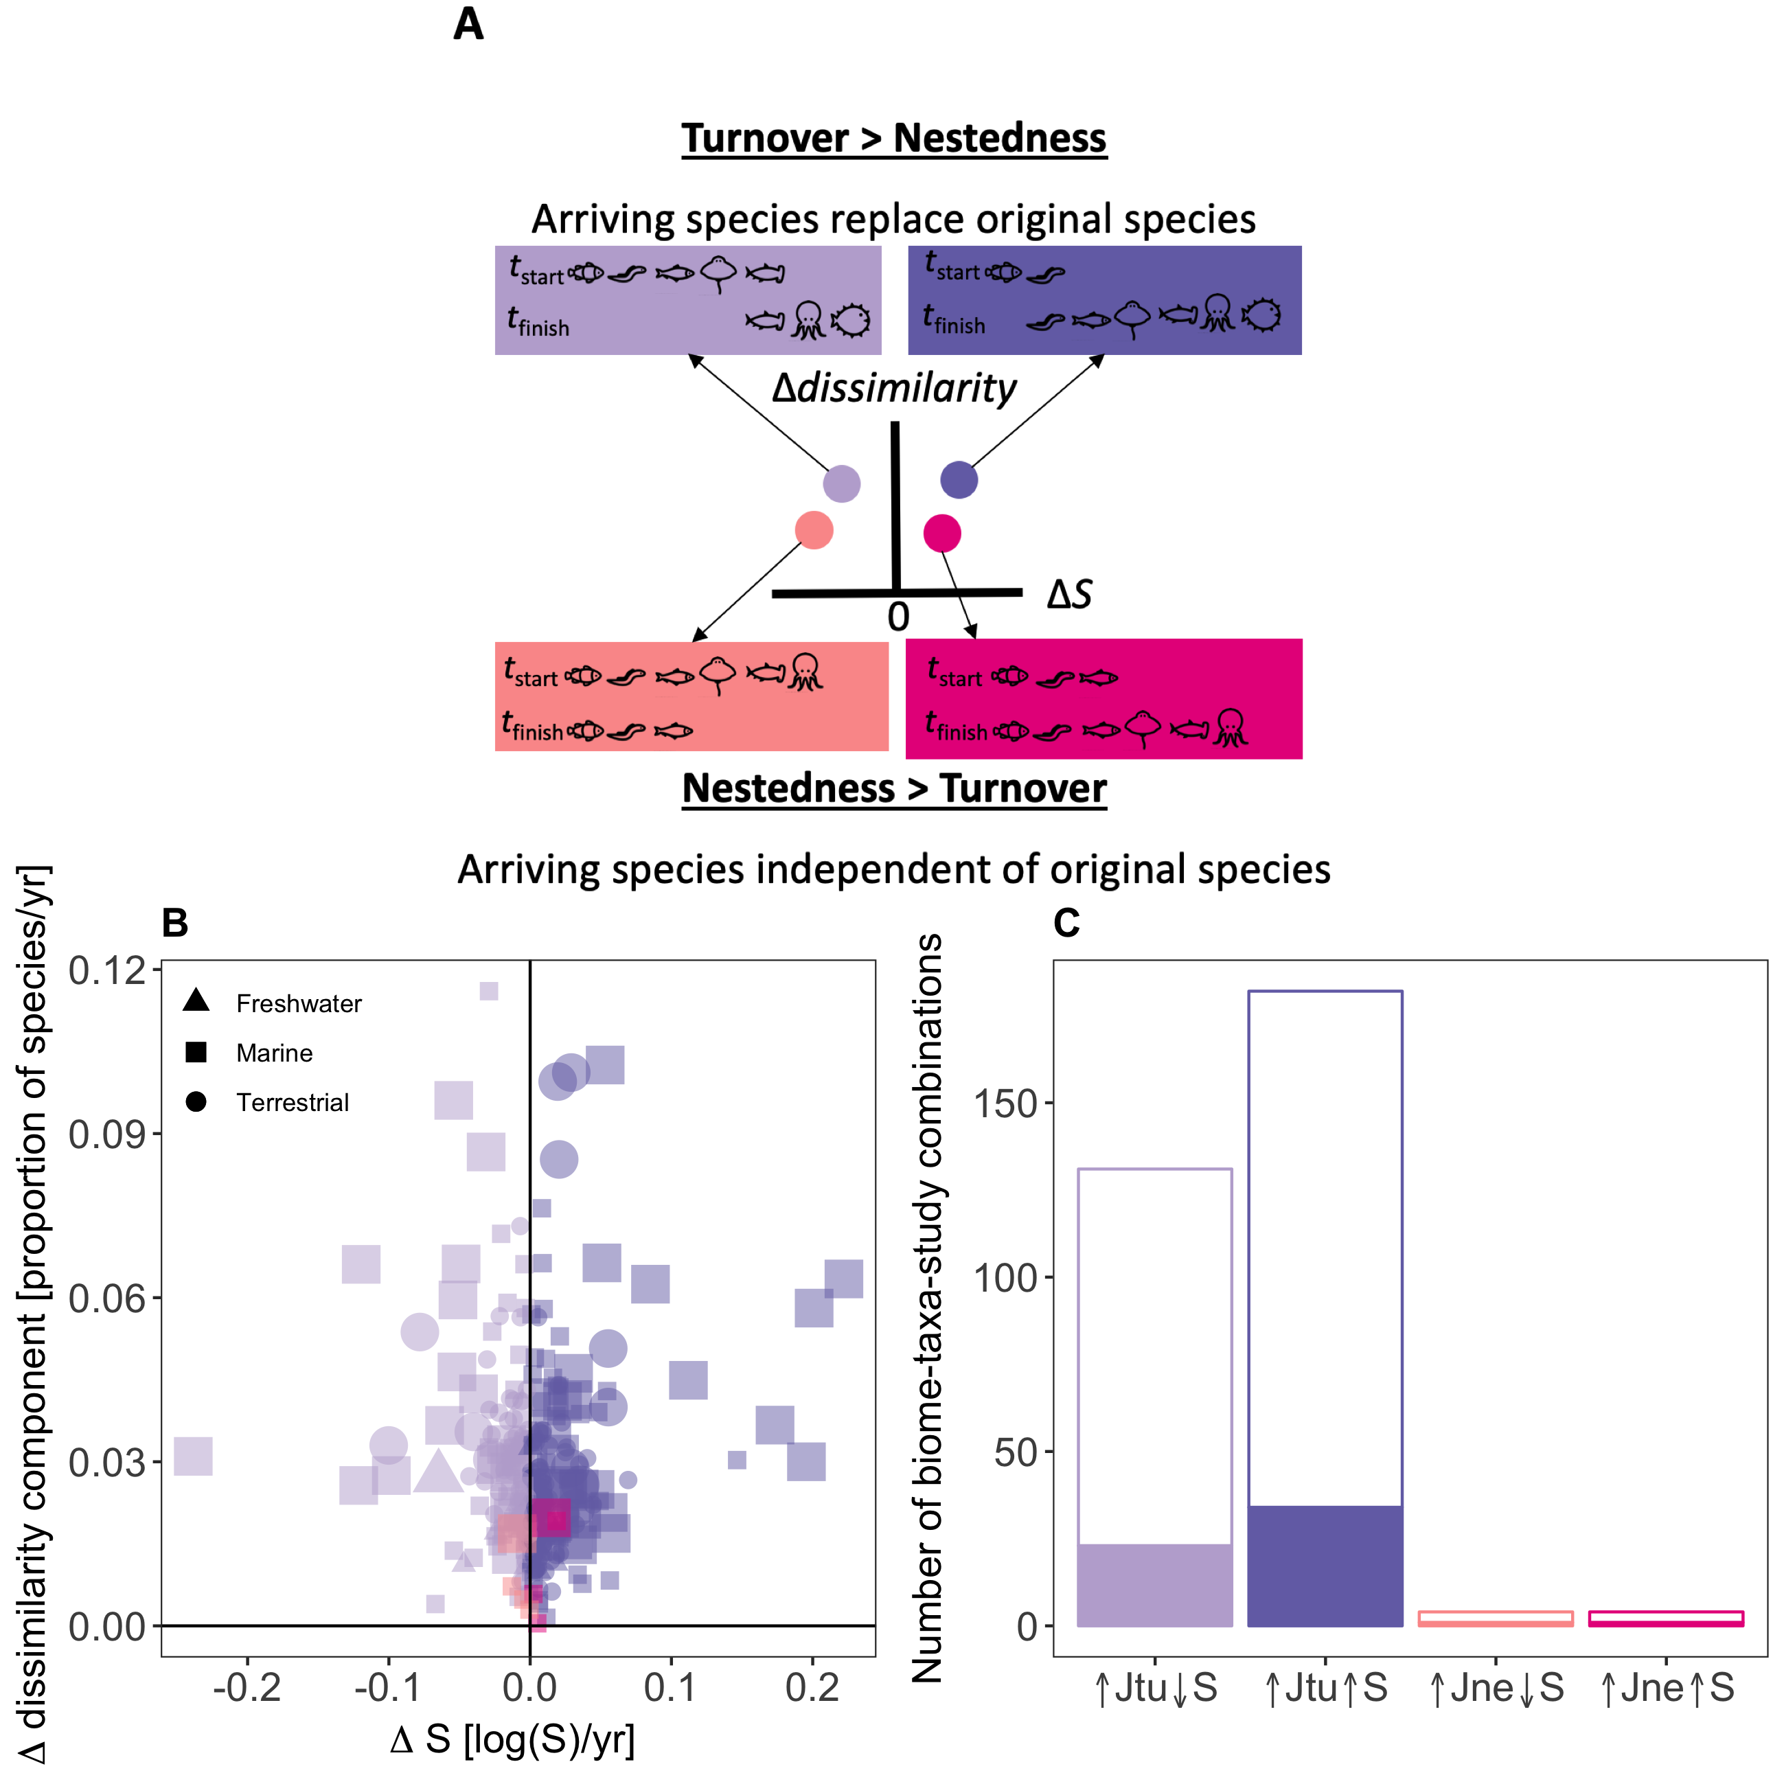
Why 𝛽-diversity?
Compositional turnover (temporal 𝛽-diversity) is widespread, and faster in marine compared to terrestrial assemblages.
However, compositional change is often decoupled from changes in richness.
Blowes et al. 2019 Science

Slide 30
Exercise: How do evenness and aggregation influence 𝛽-diversity?
Use mobsim to simulate random and aggregated communities
Sample from communities
Draw rarefaction curves at 𝛼- and 𝛾-scales
Calculate 𝛽-diversity

